Slide 1
Final Engagement
Attack, Defense & Analysis of a Vulnerable Network

Slide 2
Table of Contents
This document contains the following resources:
Network Topology & Critical Vulnerabilities
Alerts Implemented
Hardening
Implementing Patches

Slide 3

Network Topology
& Critical Vulnerabilities
‹#›

Slide 4
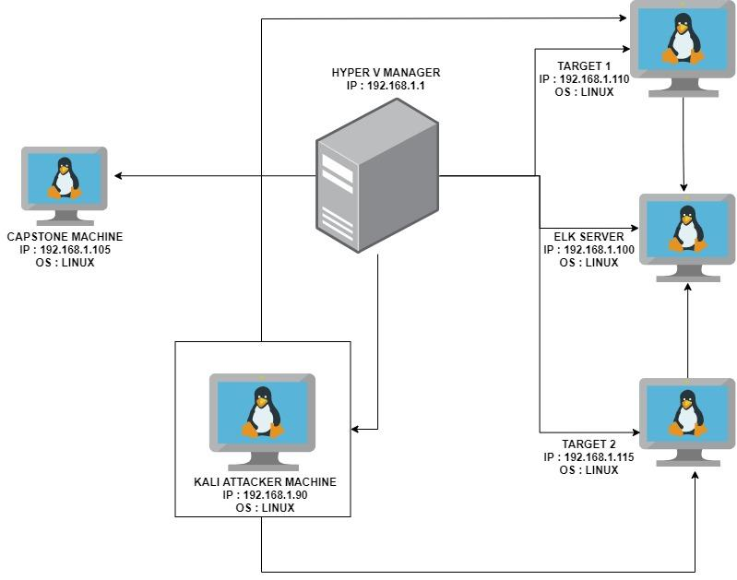
Network Topology
Network
Address Range: 192.168.1.0/24
Netmask: 255.255.255.255
Gateway: 10.0.0.1
Machines
IPv4: 192.168.1.90
OS: LINUX
Hostname: KALI
IPv4: 192.168.1.100
OS: LINUX
Hostname: ELK
IPv4: 192.168.1.110
OS: LINUX
Hostname: TARGET 1
IPv4: 192.168.1.115
OS: LINUX
Hostname: TARGET 2

Slide 5
Critical Vulnerabilities: Target 1
Our assessment uncovered the following critical vulnerabilities in Target 1.
Vulnerability | Description | Impact
WEAK PASSWORD | A USER ON THE SYSTEM HAS A WEAK PASSWORD WHICH WAS EASILY GUESSED. THE PASSWORD WAS THE SAME AS THE USERNAME. | AN ATTACKER CAN GUESS THE PASSWORD AND GAIN ACCESS VERY EASILY TO THE SYSTEM.
WORDPRESS ENUMERATION | wpscan enumeration will scan for vulnerabilities on the wordpress site and enumerate users. | An attacker will gain access to users on the site and any vulnerabilities related to the wordpress site.
ALLOWS ESCALATING PRIVILEGES TO ROOT WITH A PYTHON SCRIPT. | The system allowed for escalation of privileges to root with a simple python script after gaining access. | With root access, an attacker can inflict major damages to a compromised machine.

Slide 6
Critical Vulnerabilities: Target 1
continued
Vulnerabilities
Vulnerability | Description | Impact
Wordpress configuration file for SQL databases stored in plain text. | The username and password for the sql database was stored in plain text in the wp-config.php file | This grants an attacker access to the sql database and sensitive information.

Slide 7
Critical Vulnerabilities: Target 2
Our assessment uncovered the following critical vulnerabilities in Target 2.
Vulnerability | Description | Impact
APACHE VERSION OUTDATED | A simple nikto scan revealed the apache version running in this server is outdated and vulnerable. | Bad actors could exploit vulnerabilities related to the outdated version and gain access to the server.
VULNERABLE TO URL BRUTE FORCING. | This vulnerability allows an attacker to brute force and discover directories on a server | Attackers can gain access to hidden directories within the server.
NETCAT REVERSE SHELL AND REMOTE CODE EXECUTION. | A bash script was uploaded to the server, using a netcat listener and the browser, a reverse shell was achieved. | A reverse shell will grant an attacker unauthorized access to the server and to sensitive data

Slide 8
Alerts Implemented
‹#›

Slide 9
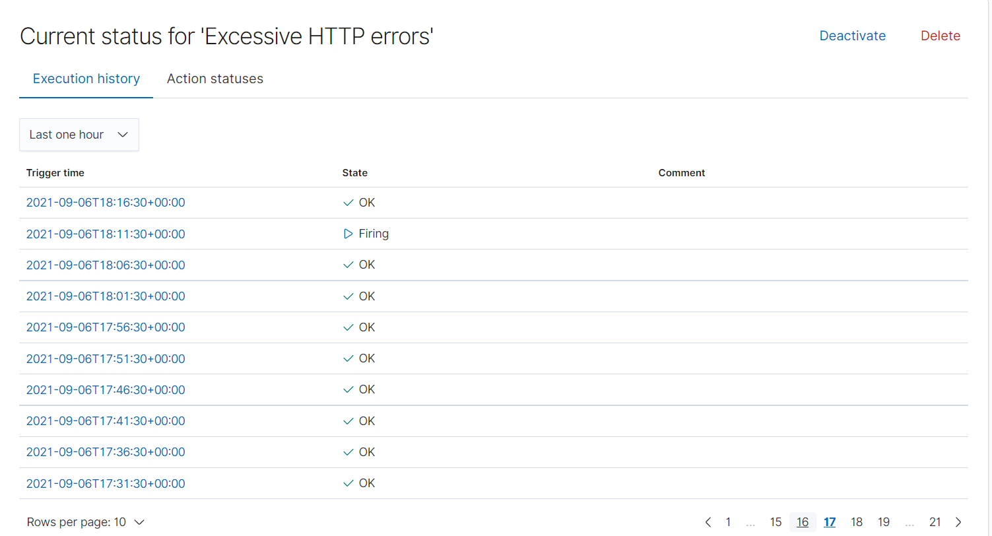
Excessive HTTP Errors
Metric : Packetbeat* : WHEN count() GROUPED OVER top 5 'http.response.status_code' IS ABOVE 400 FOR THE LAST 5 minutes
Threshold : 400

Slide 10
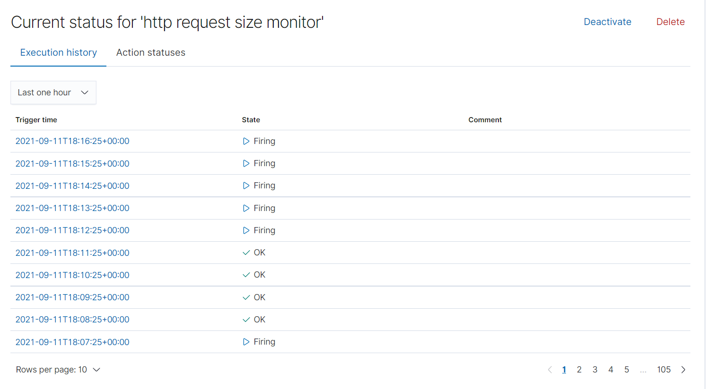
HTTP Request Size Monitor
Metric : Packetbeat* = WHEN sum() of http.request.bytes OVER all documents IS ABOVE
Threshold : 3500 FOR THE LAST 1 minute

Slide 11
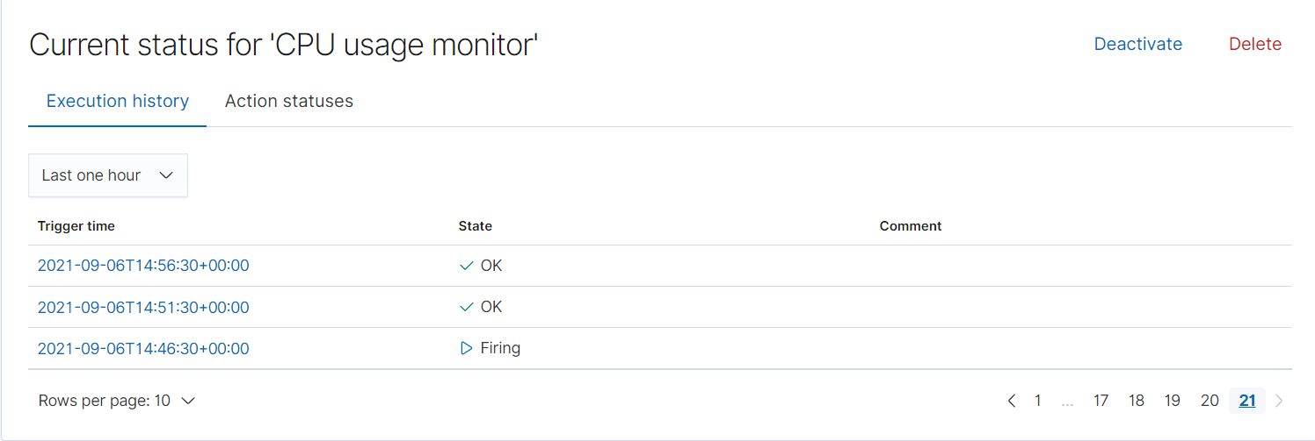
CPU Usage Monitor
Metric : metricbeat* = WHEN max() OF system.process.cpu.total.pct OVER all documents
Threshold : IS ABOVE 0.5 FOR THE LAST 5 minutes

Slide 12
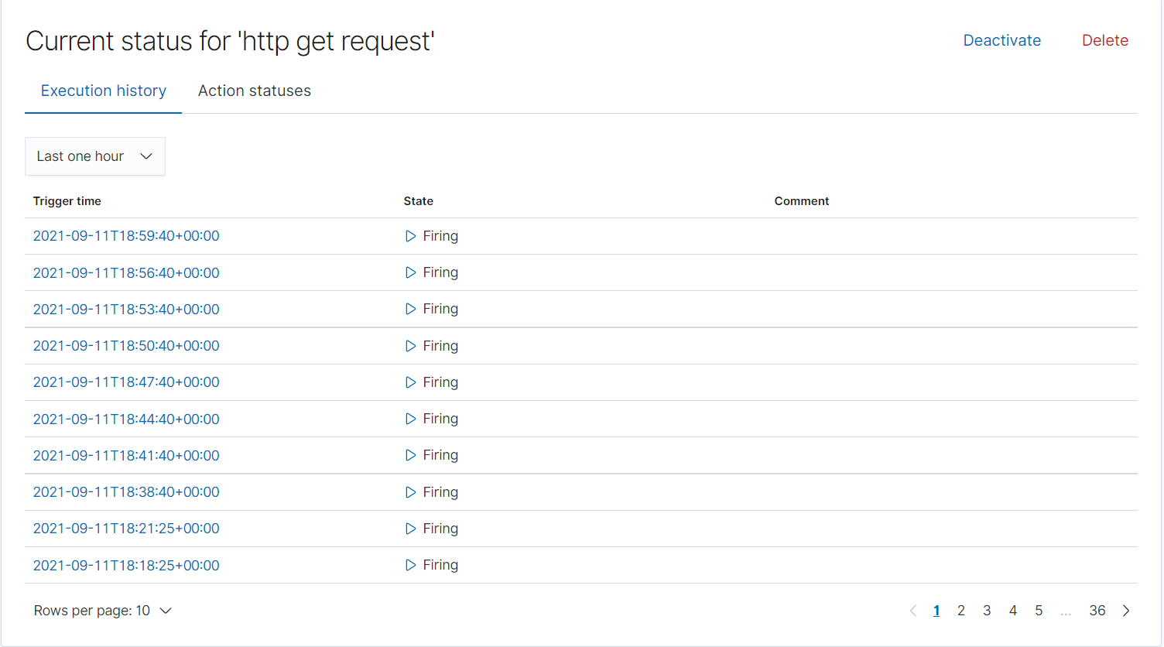
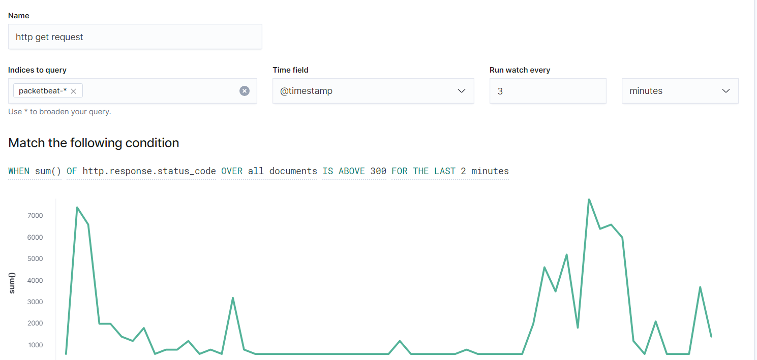
HTTP GET REQUEST
Continued
Metric : Packetbeat* = WHEN sum() OF http.response.code OVER all documents
Threshold : IS ABOVE 300 FOR THE LAST 2 minutes

Slide 13
Hardening
‹#›

Slide 14
Hardening Against WEAK PASSWORD on Target 1
Strong password policy for all employees to include special characters, numbers and upper cases this will prevent password guessing and reduce vulnerability to brute force attacks.
Regular password update for all employees, preferably every 3 months, as stated above this will prevent user account compromise and harden against brute force attacks.
Implementing MFA for all users on the system.
Creating a whitelist of trusted IP’s that are allowed to access port 22 via SSH.
Network security rule blocking any IP where 5 consecutive failed SSH attempts to port 22 originates from.

Slide 15
Hardening Against WORDPRESS USER ENUMERATION on Target 1
Disable the WordPress REST API if not in use.
Disabling WordPress XML-RPC if it’s not in use.
Configuring the web server to block requests to /?author=<number>. This will prevent a wpscan from enumerating users on the wordpress site.
Disable access from the public to the /wp-admin and /wp-login.php directories.
Regular update to the Wordpress to patch any discovered vulnerabilities.

Slide 16
Hardening Against ESCALATING PRIVILEGE TO ROOT on Target 1
Permission and roles management of existing and new users to prevent vertical or horizontal privileges escalating to unauthorized users.
Enforce least privilege by removing admin rights from users and reduce application and machine privileges to the minimum required. Just-in-time access should also be implemented to reduce persistent or standing privileges.
Vulnerability management by continuously identifying and addressing vulnerabilities, such as with patching, fixing misconfigurations, eliminating default or embedded credentials.
Monitor and manage all privileged sessions to detect and quickly address any suspicious activity that might indicate an exploited account or an illegal attempt at privilege escalation.

Slide 17
Hardening Against APACHE VERSION OUTDATED on Target 2
Updating the apache version on the server to the latest version.
Regular checks to deploy patches or updates to all services running within the network. This will protect against any vulnerabilities attackers might use to gain access.

Slide 18
Hardening Against URL BRUTE FORCING on Target 2
Implement an intrusion detection system that recognises the success/fail traffic pattern and either blocks/drops or rate limits the client IP.
Implement authentication mechanism like CAPTCHA forms to reduce the effectiveness of automated tools.
Regular audit to remove empty directories and temporary files used in the running of your web site.
Disabling access from the public to sensitive directories within the website page.

Slide 19
Hardening Against NETCAT REVERSE SHELL AND REMOTE CODE EXECUTION on Target 2
Validating user input into the web server.
Using an online injection tools to mitigate web attacks.
Restricting the upload of files into the server to only a pre-approved list of users.
Scanning a file uploads into the server to detect and block any malicious file extension.

Slide 20
Implementing Patches
‹#›

Slide 21
Implementing Patches with Ansible
Playbook Overview
Ansible could be used together with a cron job and automate system wide updates on all services as well as keeping the necessary tools up to date. Ansible could also be used to check and verify the system health by ensuring web servers are up and running. below is an example of a playbook that can be configured to run daily/weekly/monthly to check for and install needed patches and updates to services running within a server.
--
-name: update apt-get repo and cache
hosts: webservers
apt: update_cache=yes force_apt_get=yes cache_valid_time=3600
-name: check if reboot required
-register: reboot_required_file
-stat: path=/var/run/reboot-required get_md5=no

